Slide 1

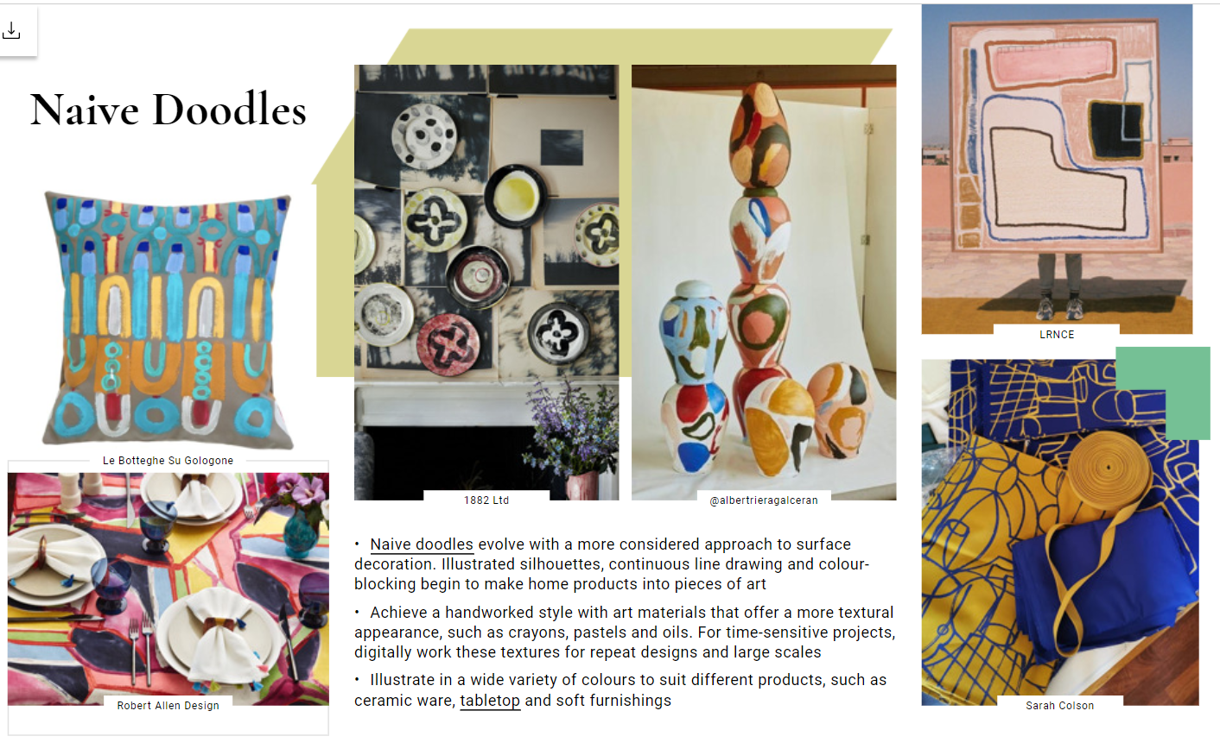
ABSTRACT EXPRESSIONISM
The inspiration for my brief is the Modernist Art Movement, in particular Abstract Expressionism. What interests me is their passion for making art that is just art.
Within this brief I aim to create a fabric-based collection for the interiors market, suitable for females 25 – 40 years, inspired by the Modernism Movement in particular Abstract Expressionism.
Professional Practice Webinars I have attended
Professionalism and Netiquette
Professional Practice Symposium
Intellectual Property
Careers in the Creative Industry
Searching for Jobs and Internships
Careers in the Fashion Industry
Social Media and LinkedIn Profiles
CV and Cover Letters
Careers in the Charity Sector
Finding Work Experience

Slide 2
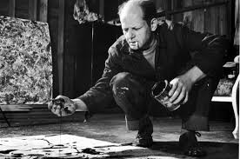
Hilma Af Klint
Jackson Pollock
Wassily Kandinsky
Mind, Body and Soul
'art for art’s sake'
“Frank Stella - ‘What you see is what you see’”.
Kandinsky viewed music as the most sublime form of abstract art and believed his paintings could communicate certain sounds. “Colour is the key. The eye is the hammer. The soul is the piano with its many chords,” he was quoted saying. “The artist is the hand, that by touching this or that key, sets the soul vibrating automatically
In 1905 she noted that she had heard a voice that had given her the following message: ‘You are to proclaim a new philosophy of life and you yourself are to be a part of the new kingdom. Your labours will bear fruit.’

Slide 3
COLOUR
Warm Colours
Reds, oranges, yellows – happiness
Cool Colours
Green, blue and purple – cool colours are cooling
Purple is creative
Happy Colours
Bright, warm and playful – yellow, orange and pink
Pastel colours are happy – uplifting
Sad Colours
They are dark and muted.
Blacks and greys

Slide 4
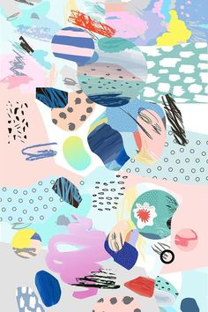
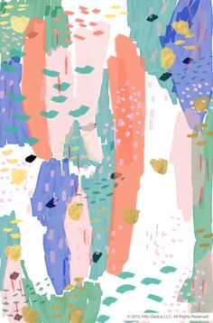
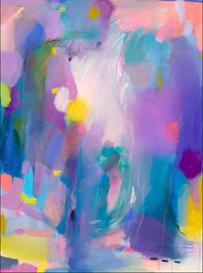

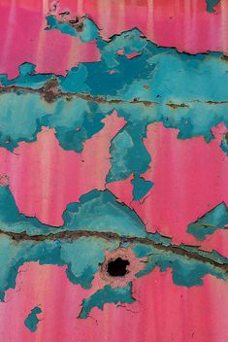
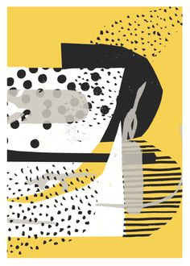
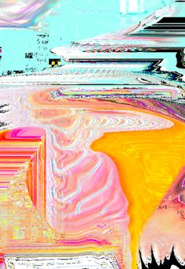
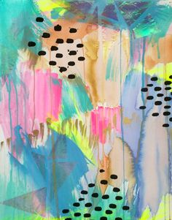

Inspiration

Slide 5

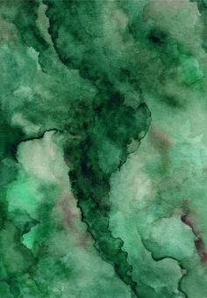




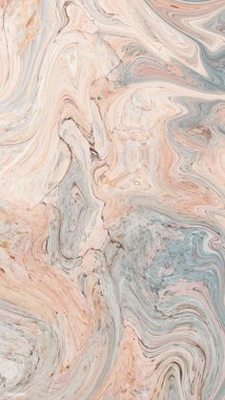
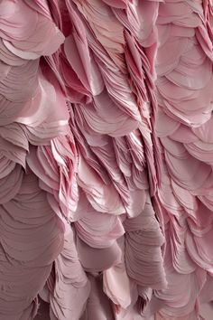

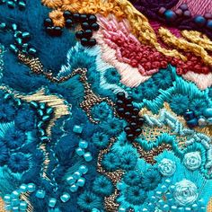
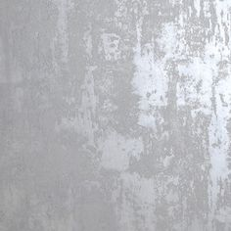
Textures

Slide 6
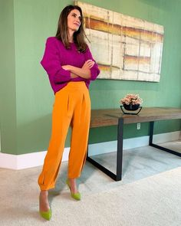
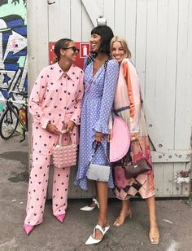
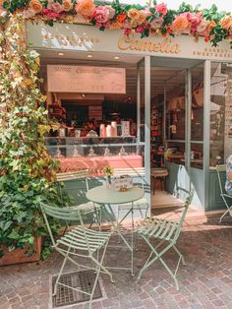
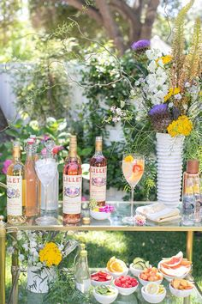
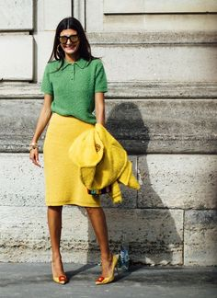
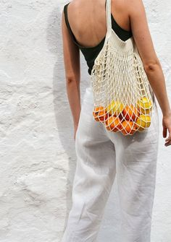
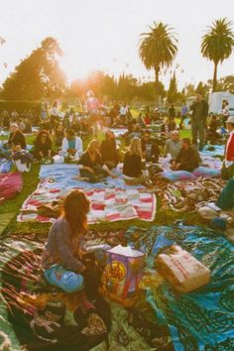



Client Profile

Slide 7
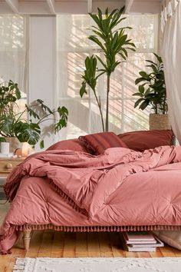
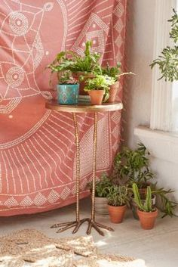
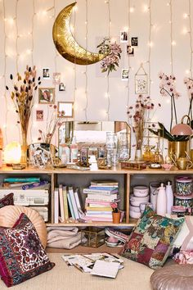
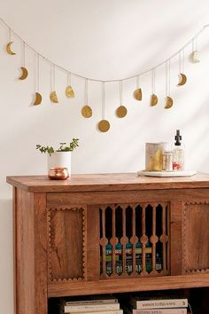
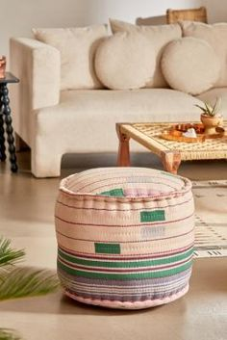
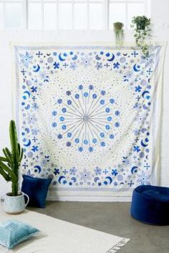
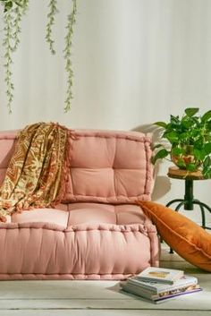
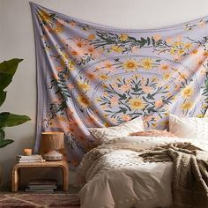
Urban Outfitter Homeware
Urban Outfitters Homeware is a potential competitor to my collection. There products are trendy and affordable which is what I am aiming for. They appeal to a young adult demographic who are looking for something on style for there homes. They have statement funky products but also items that are simple. I feel that my target market would shop here as they feel that they would find something different to furnish there homes with.

Slide 8
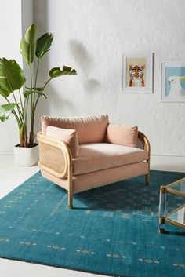
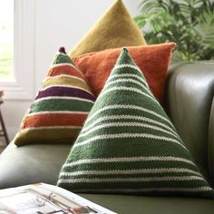
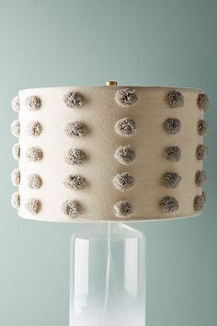
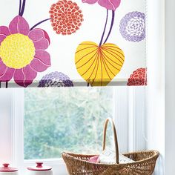
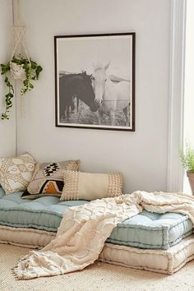
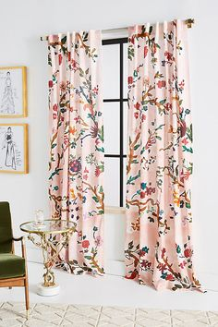
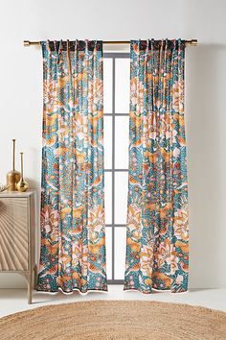
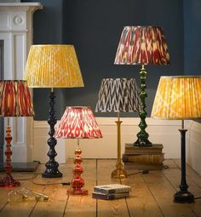
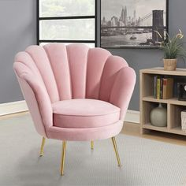
Product Ideas
Product list
Cushions
Chairs
Blankets
Prints for the wall
Lampshades
Curtains
Blinds

Slide 13
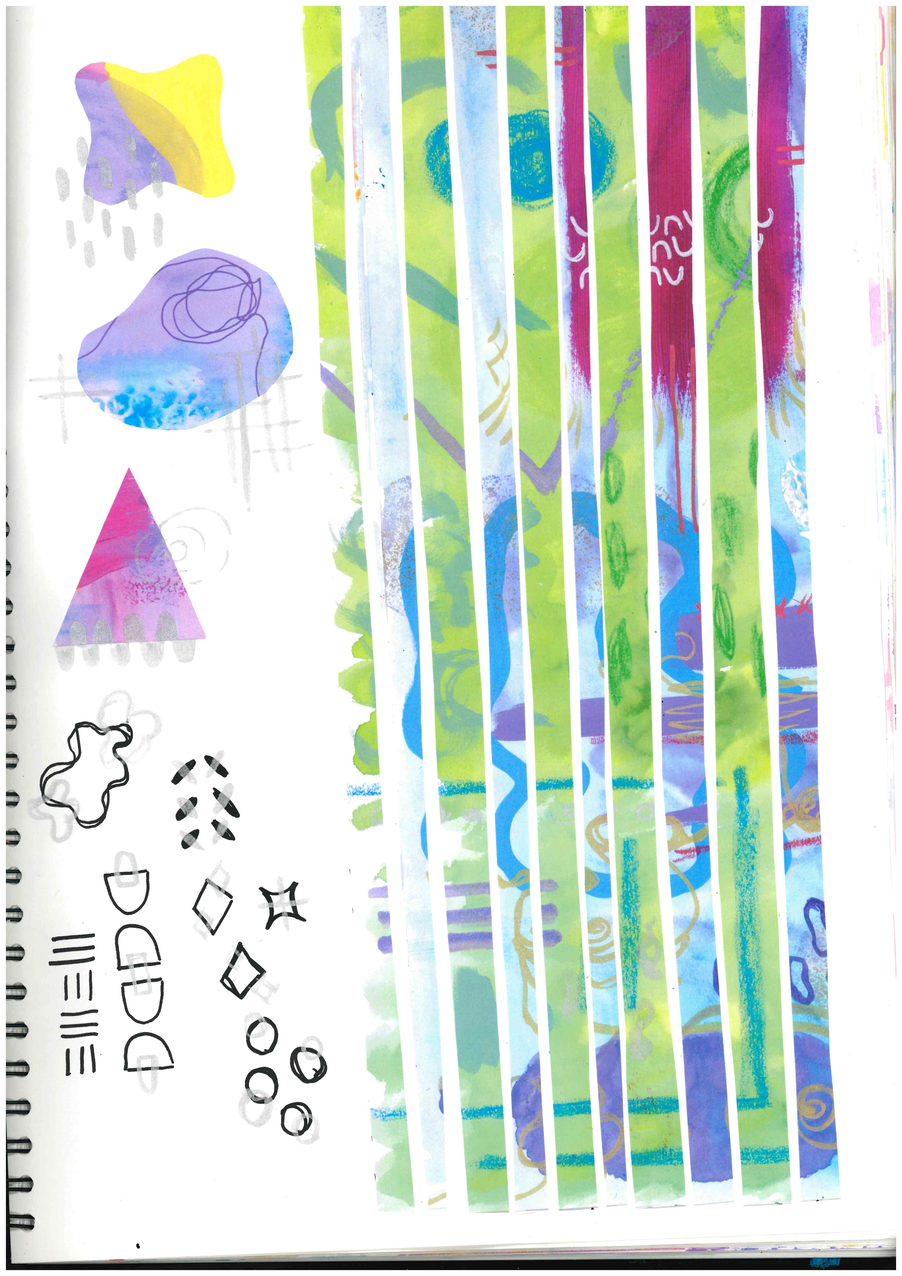
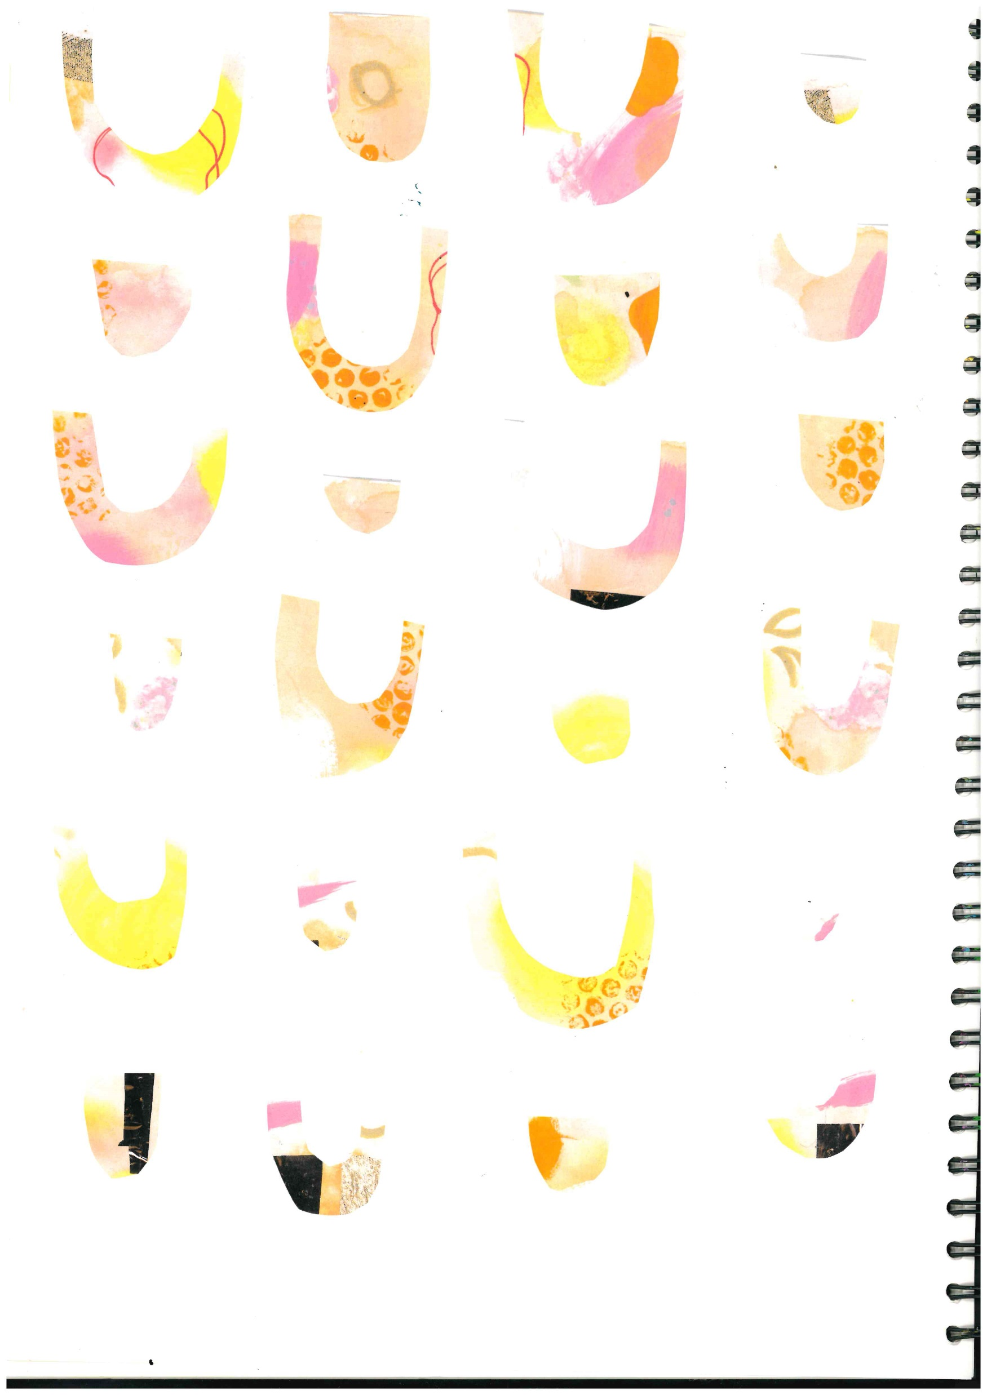


Slide 14
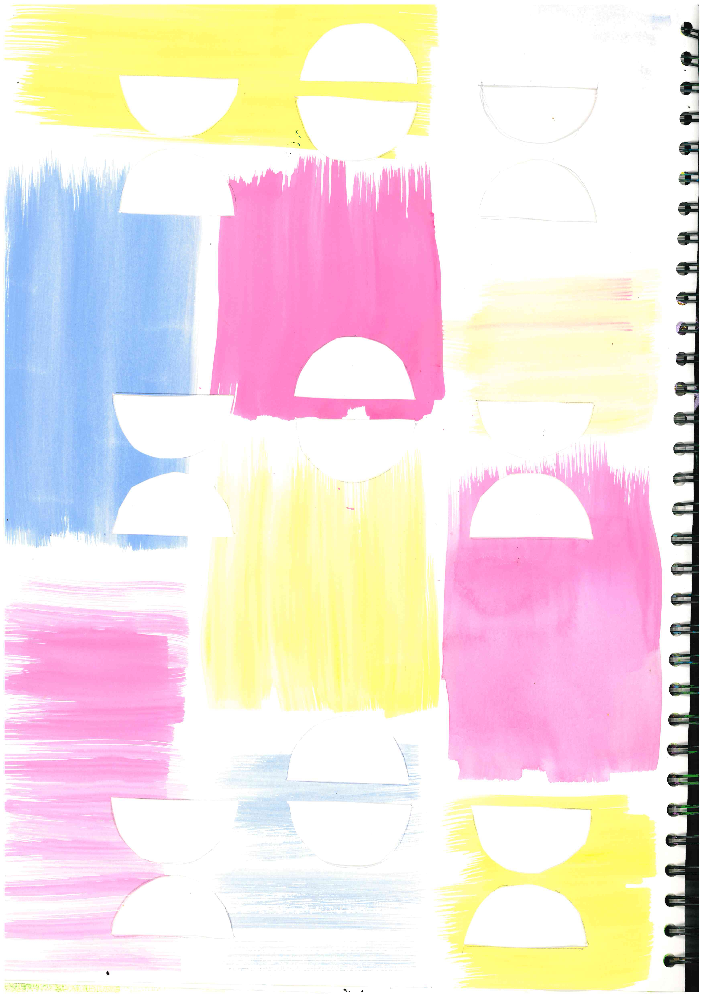
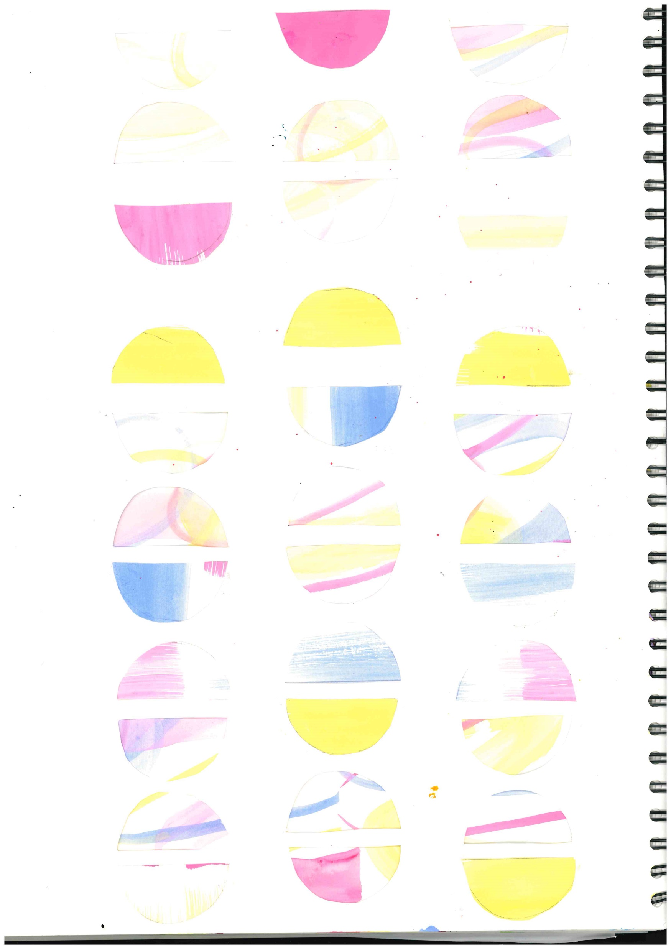
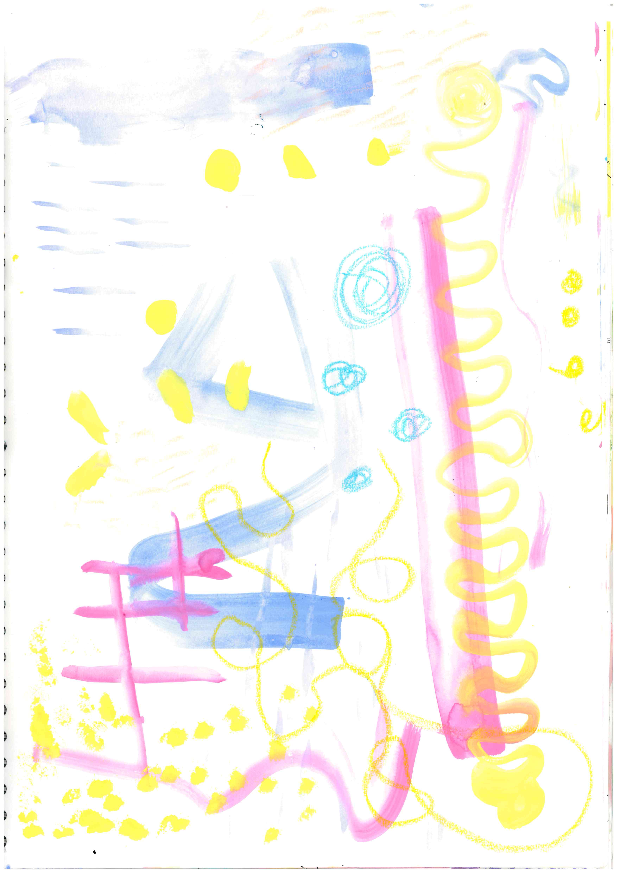
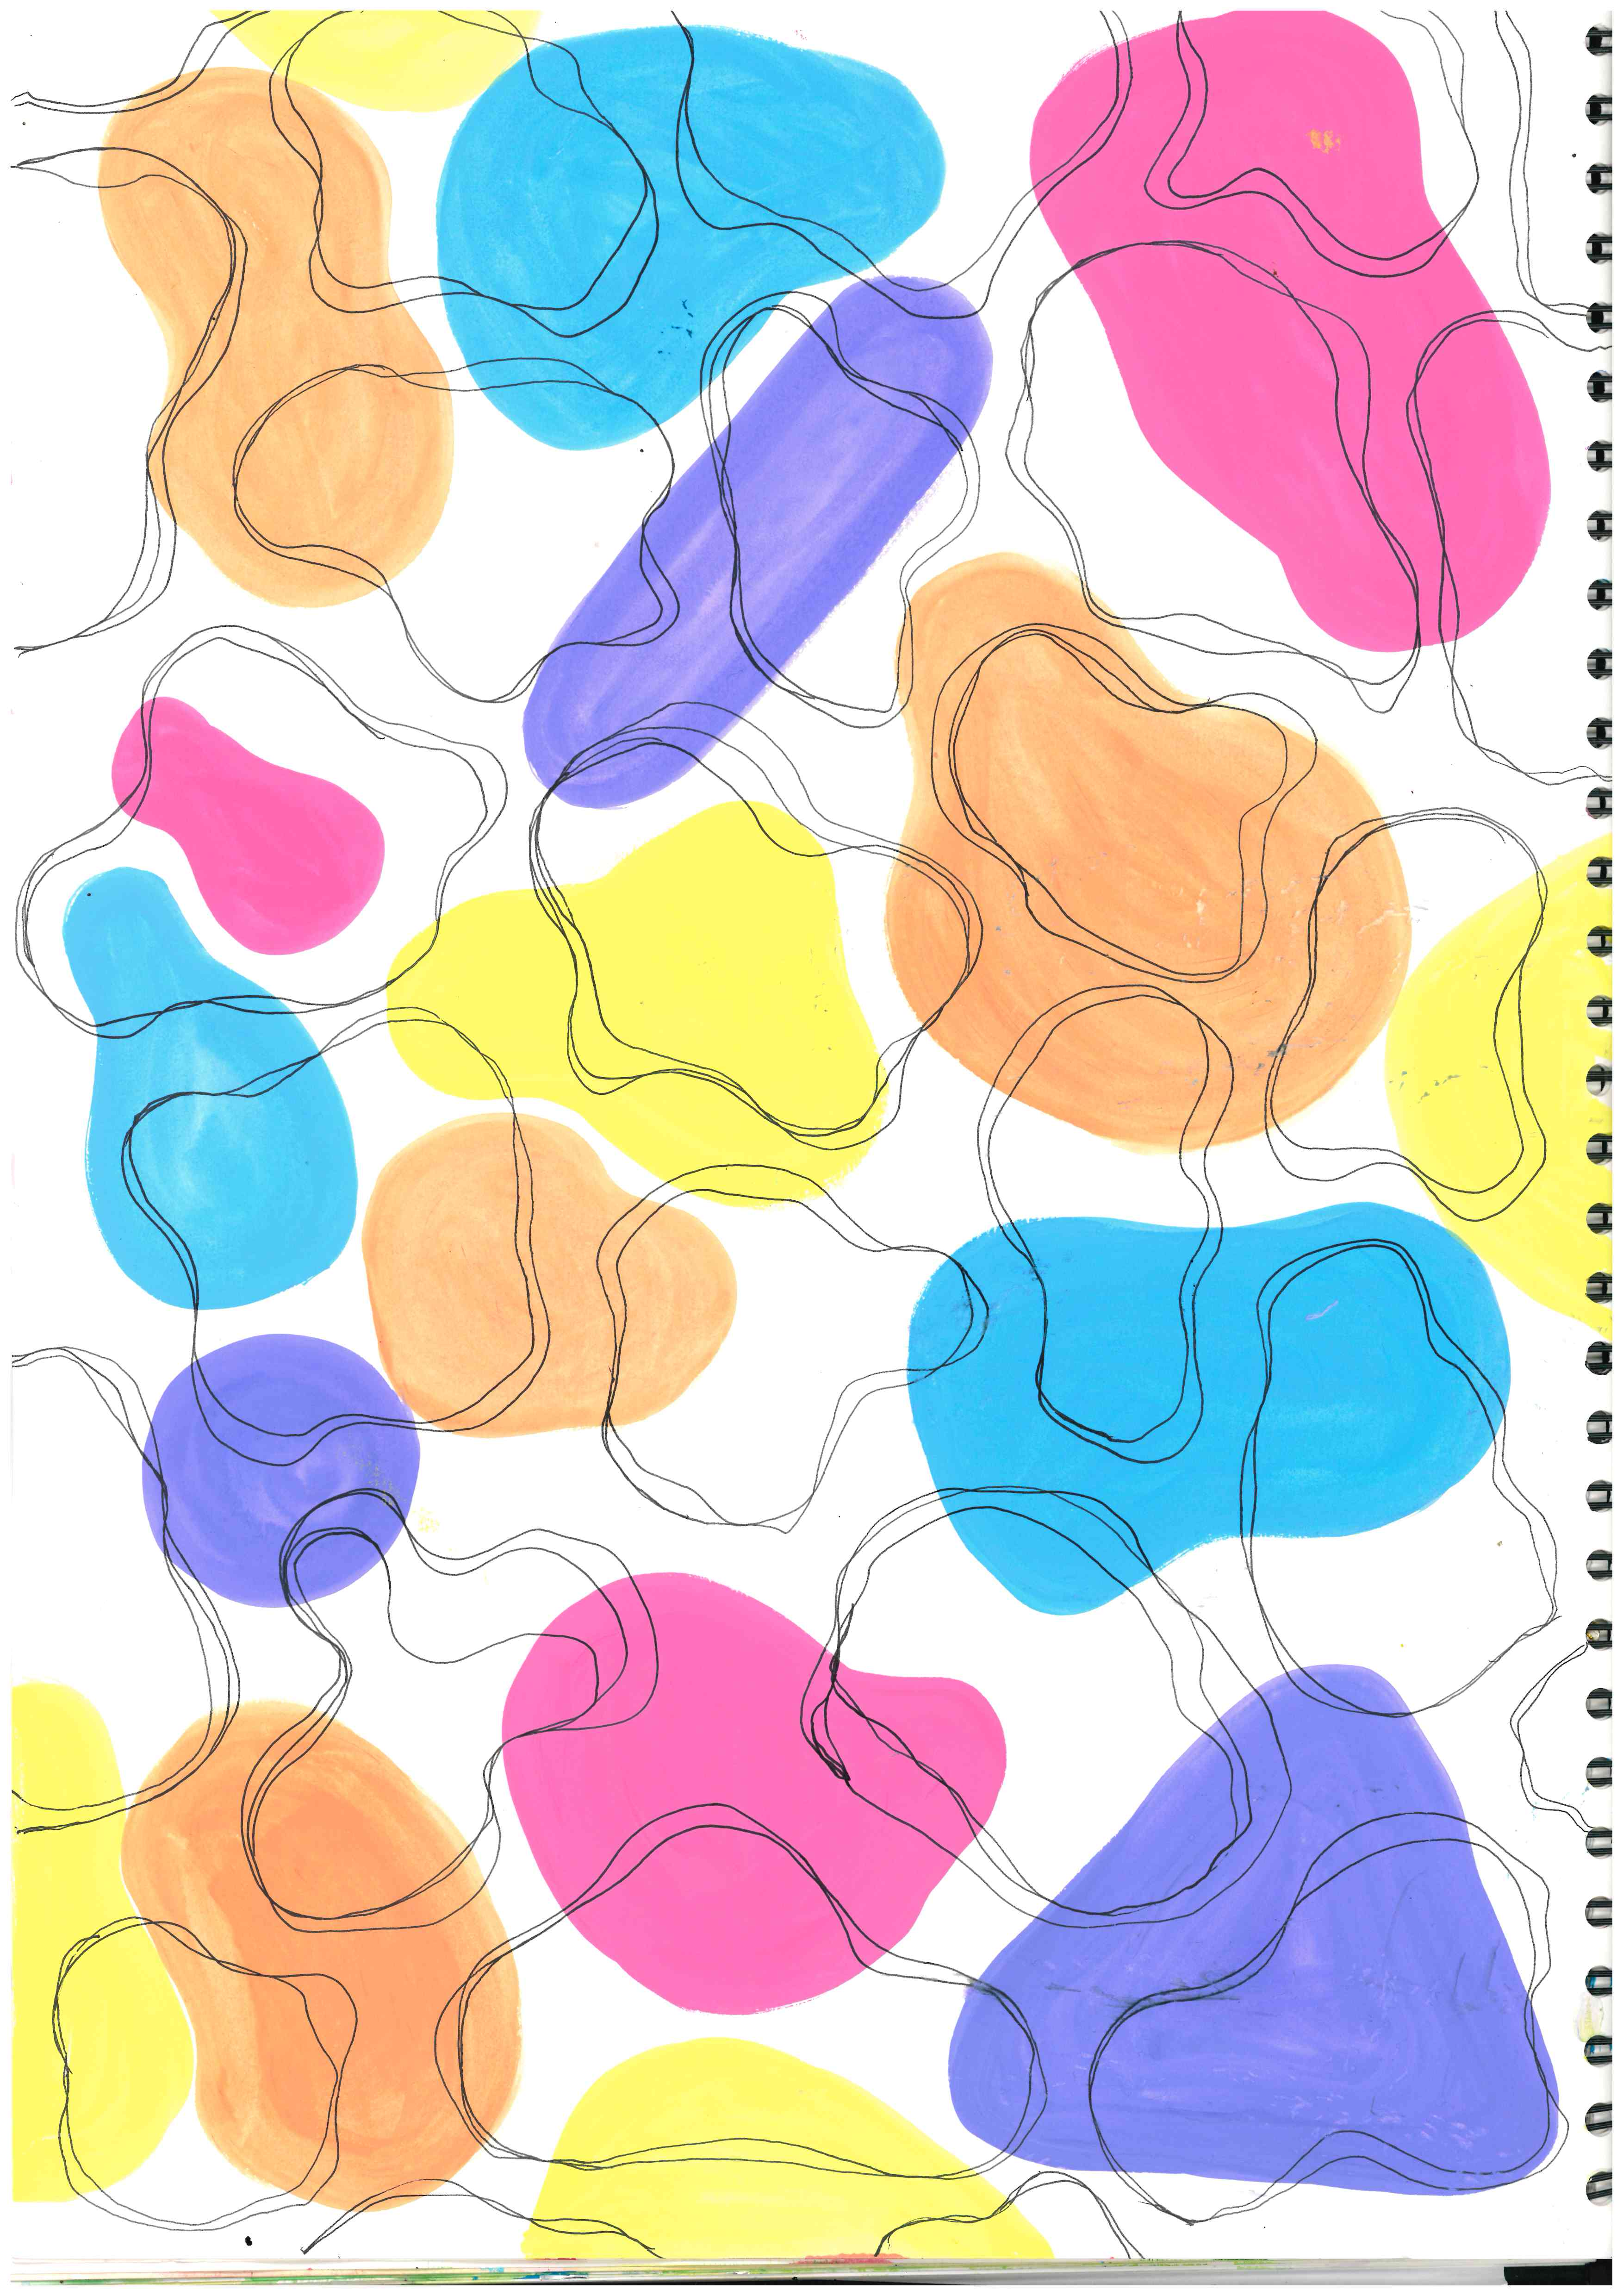
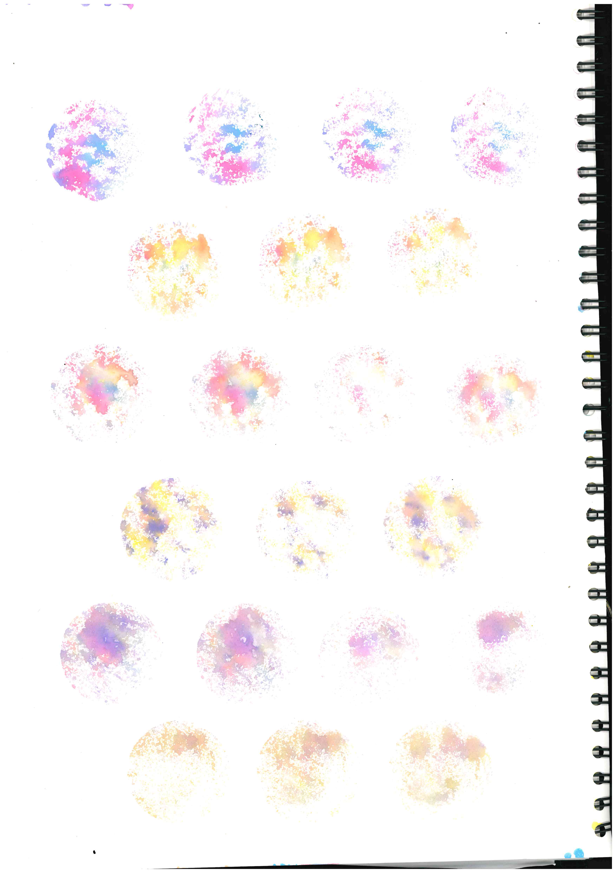

Slide 15
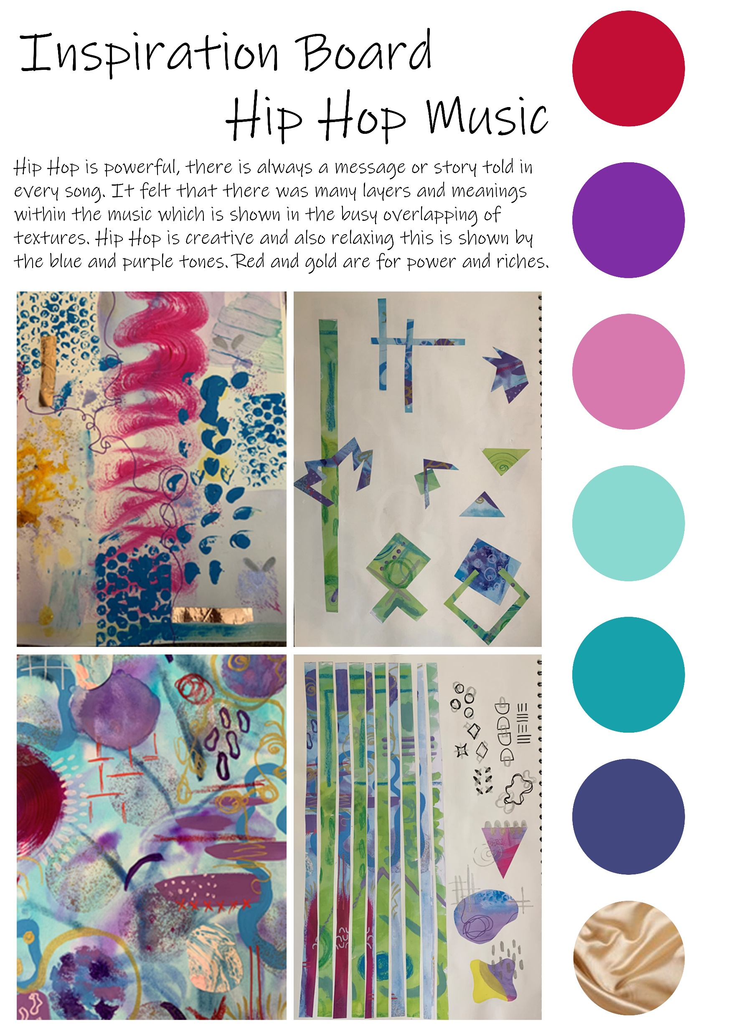
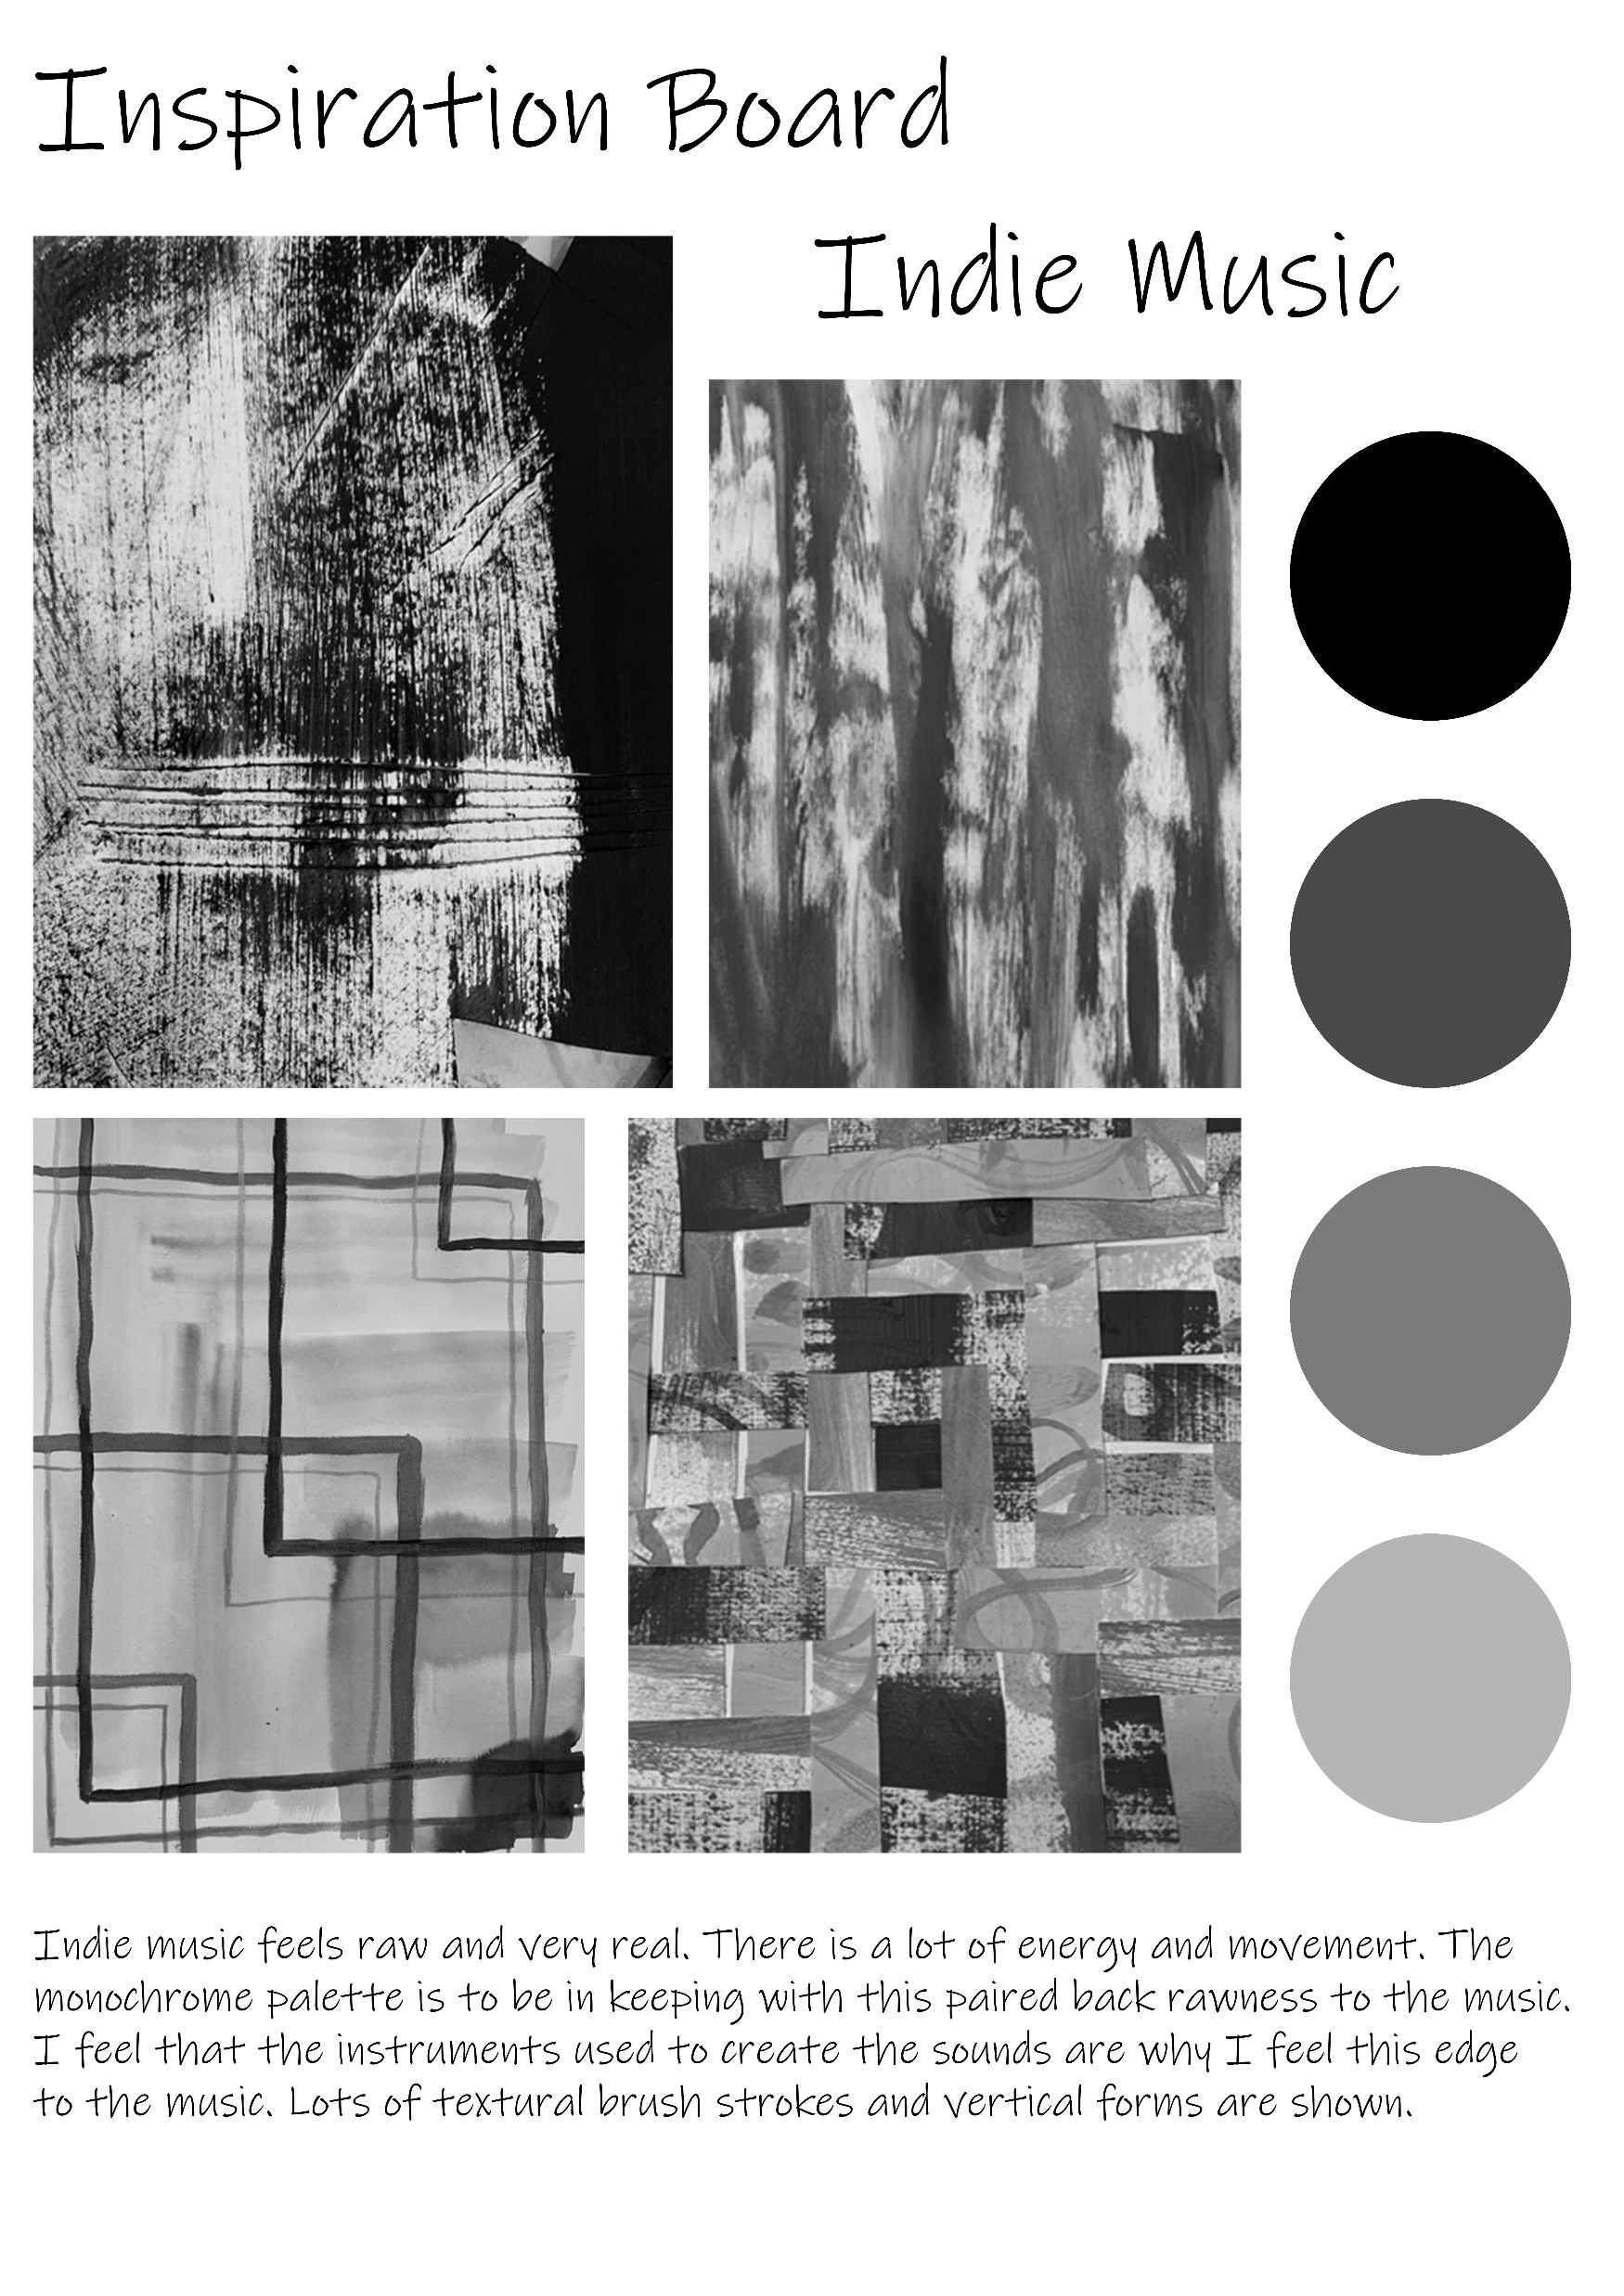

Slide 16
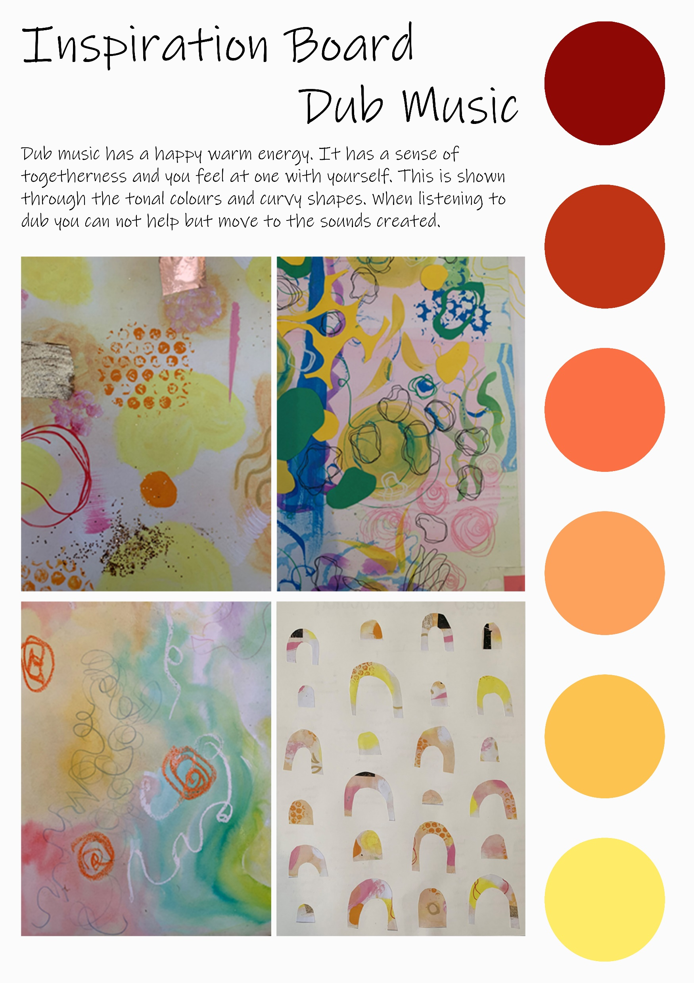
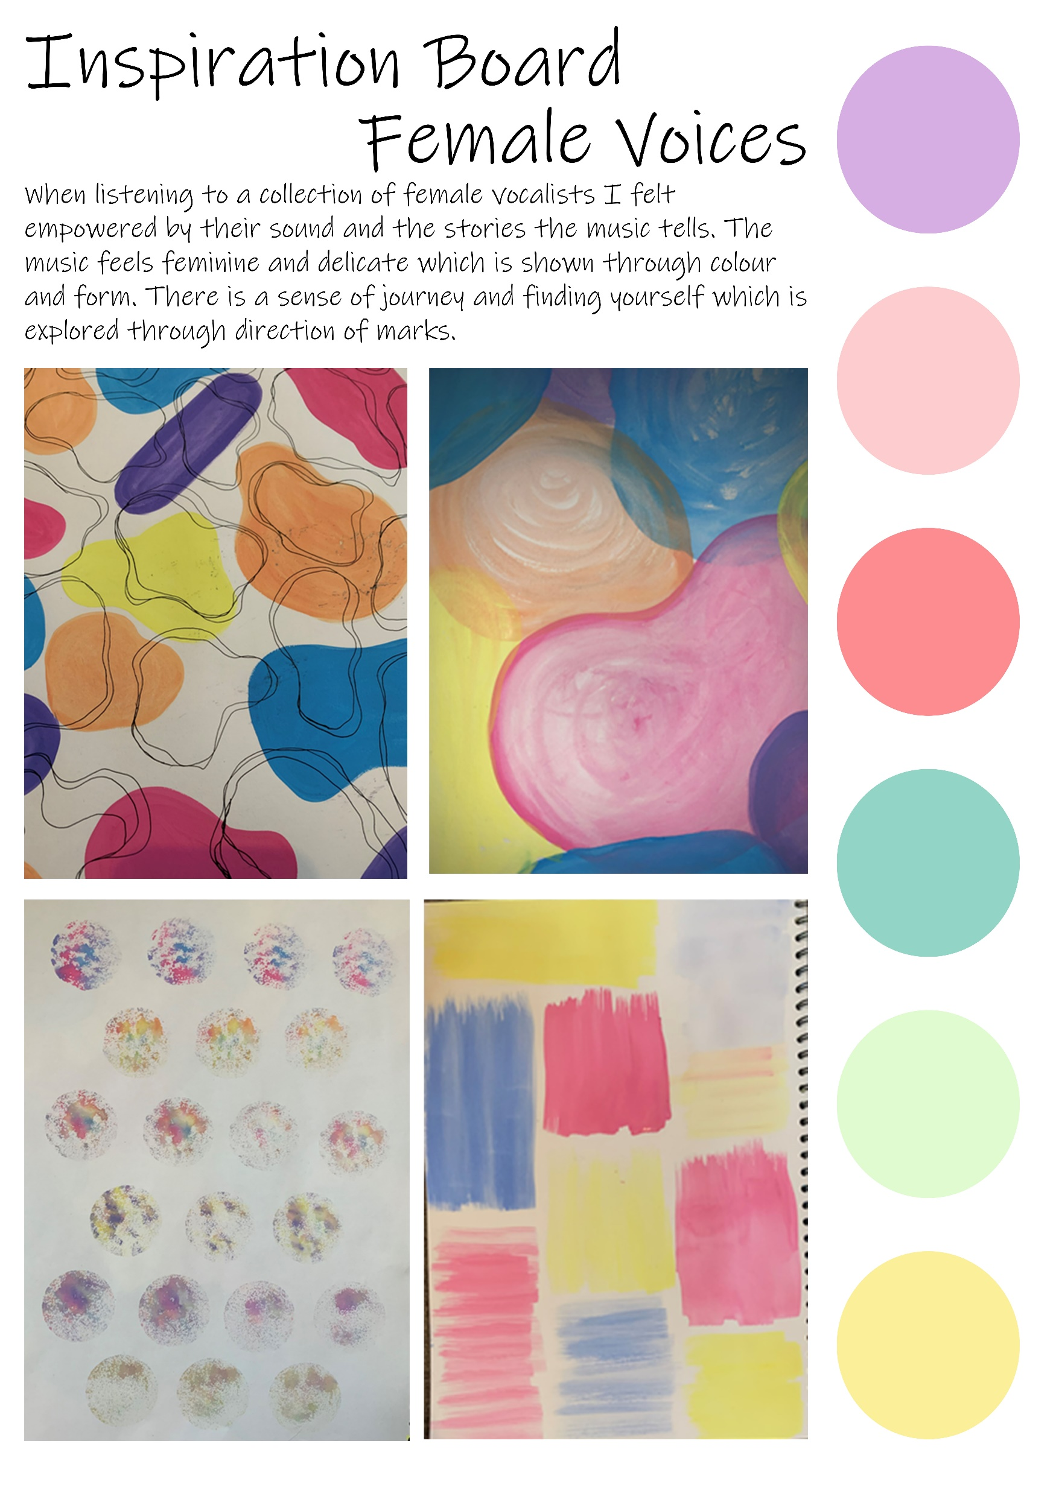

Slide 17
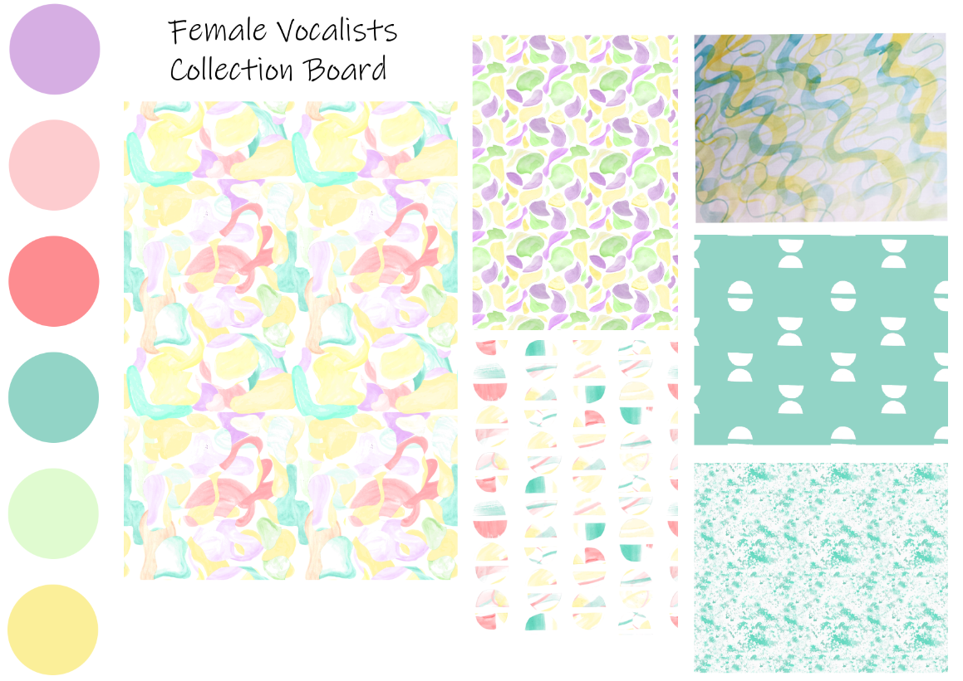

Slide 18




Slide 19



Dub Collection

Slide 20






Slide 21




