Slide 1
Fringing Foot
Chiodi Burton

Slide 2
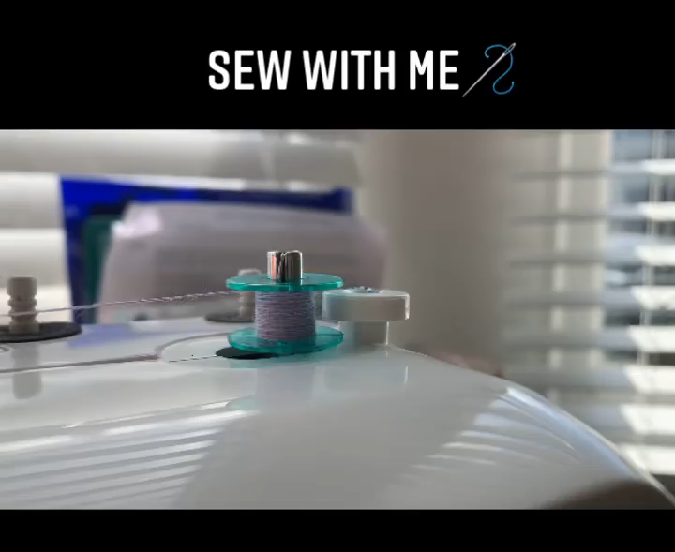

Slide 3
